Slide 1
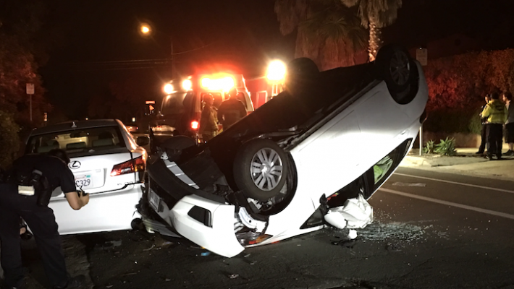

Do TNCs affect DUI Deaths?
By Drew Russell, Mayssa Maring, Aaron Kim
The [2] Amigos

Slide 2

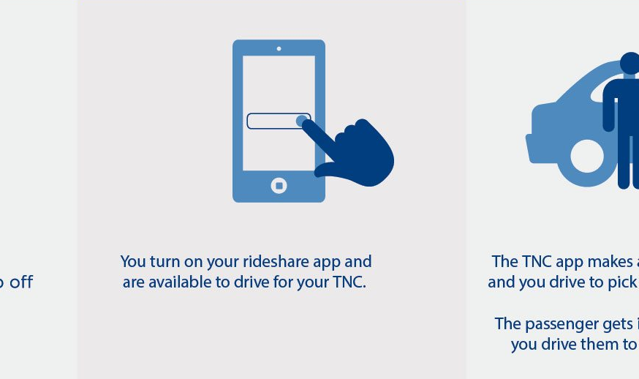
Transportation Network Company (TNC)
Also known as mobility service provider (MSP) or ride-hailing service
Defined as a company that uses an online-enabled platform to connect passengers with drivers using their personal, non-commercial vehicles
Provide service to areas that do not have taxis normally available
Charging lower rates than taxicabs

Slide 3

Lyft
Lyft was launched in 2012 in San Francisco by Logan Green and John Zimmer as a service of Zimride, a ridesharing company the two founded in 2007
Revenue of $2.157 billion as of 2018

Slide 4
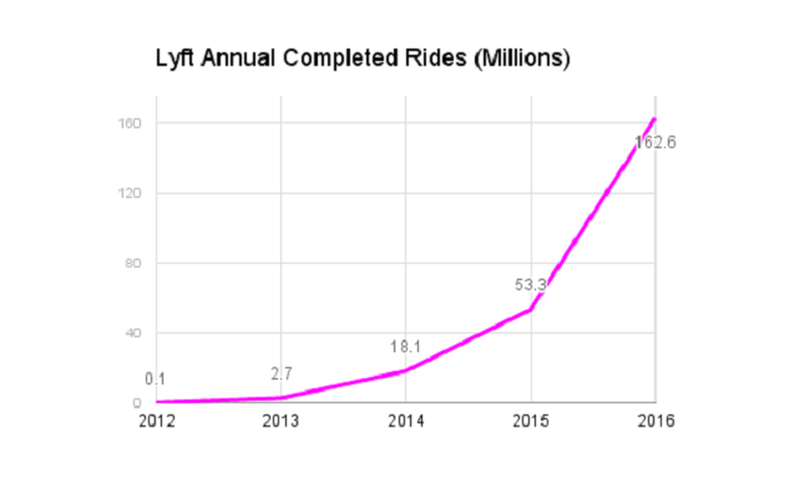
Lyft
By 2013, Lyft was providing 30,000 rides a week
By the end of 2013, it hits 2.7 million completed rides
April 2014, Lyft had become available in 60 U.S. cities
By the end of 2014, they hit 18.1 million completed rides

Slide 5

Uber
Uber was founded in 2009 as UberCab by Garrett Camp and Travis Kalanick
Revenue of $11.3 billion
Other Uber ventures:
Self-driving technology
Uber Air
Uber Eats
UberGo, rides in a hatchback

Slide 6
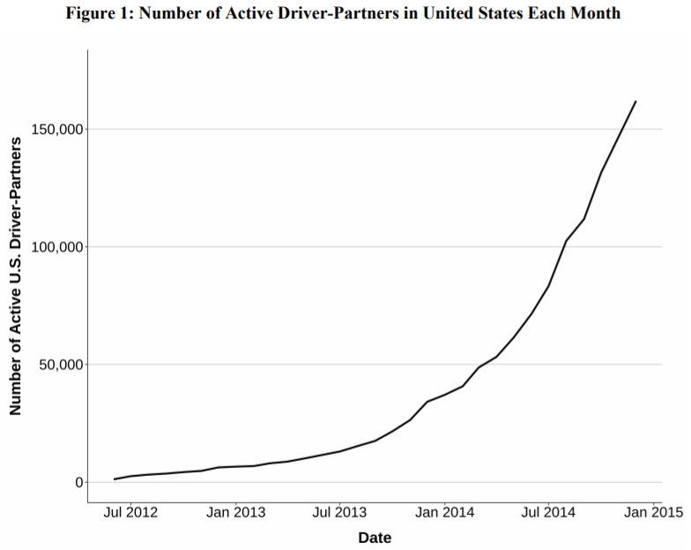
Uber
In July 2012, the company introduced UberX, using non-luxury vehicles
By early 2013, the service was operating in 35 cities as well as allowed drivers to use their personal vehicles
From a base of near zero in mid-2012, more than 160,000 drivers actively partnered with Uber at the end of 2014 in the United States

Slide 7

DUI
Driving under the influence (DUI) occurs when a person operates a motor vehicle while intoxicated
Men are most likely to be involved in this type of crash, with 4 male drunk drivers for every female drunk driver
The highest percentage of drunk drivers were 21- to 24-year-olds, at 27 percent, followed by 25- to 34-year-olds, at 26 percent.

Slide 8
Questions
Was there an immediate impact on DUI deaths with the introduction of TNCs?
Which gender has the highest death rates, and which had the highest impact?
Which age group has the highest death rates, and which had the highest impact?

Slide 9

Our Data
Impaired Driving Death Rate
By Age
By Gender
By State
2012-2014

Slide 10
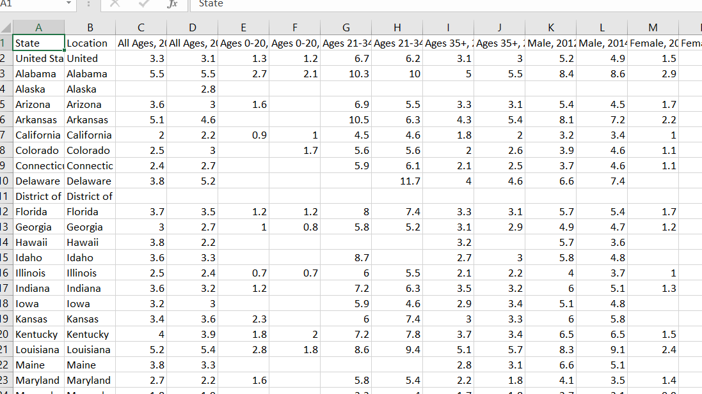
Our Data Process
Import CSVs into Jupyter Notebook
Begin determining the data we wanted to analyze
Cleaned the data
Created tables with the relevant data
Plotted charts with the data
Analyzed the results

Slide 11
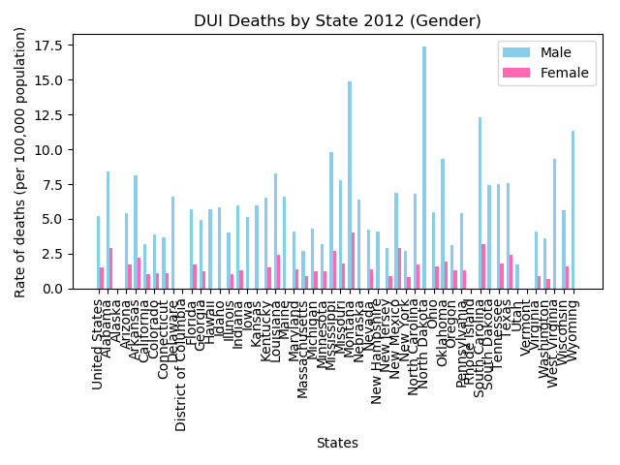
DUI Deaths by State (2012)
Used to compare Gender by States
Men in North Dakota had the highest rate of deaths
Men in Utah had the lowest rate of deaths
Women in Montana had the highest rate of deaths
Women in West Virginia had the lowest rate of deaths

Slide 12
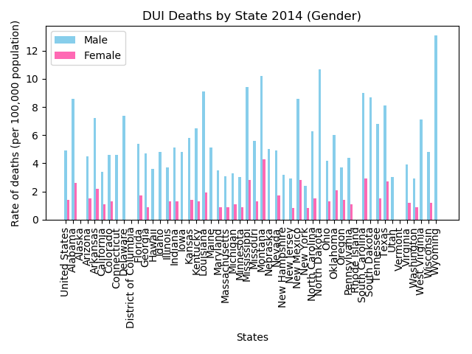
DUI Deaths by State (2014)
Used to compare Gender by States
Men in Wyoming had the highest rate of deaths
Men in New York had the lowest rate of deaths
Women in Montana had the highest rate of deaths
Women in New York had the lowest rate of deaths

Slide 13
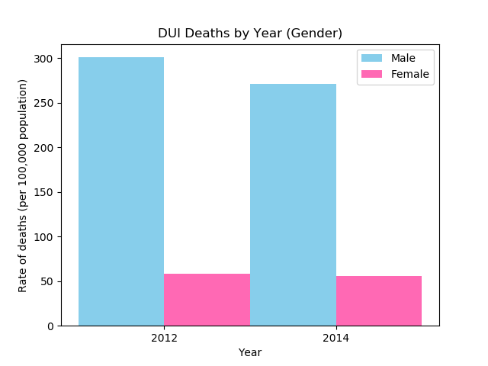
DUI Deaths by Year
Men have much higher rates of deaths in both years
10% decrease in deaths for Males in 2014
Little to no change in deaths for Women in 2014
Men account for 84% of all DUI deaths in 2012
83% in 2014

Slide 14
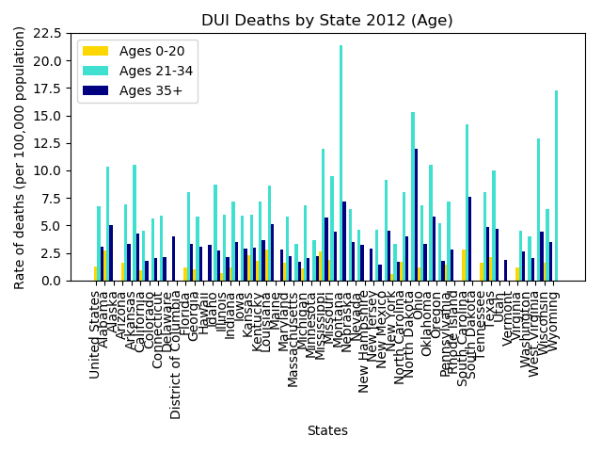
DUI Deaths by State (2012)
Ages 21-34 had the highest rates
Highest in Montana
Lowest in Massachusetts
Ages 0-20 had the lowest rates
Highest in South Carolina
Lowest in New York
Ages 35+
Highest in North Dakota
Lowest in New Mexico

Slide 15
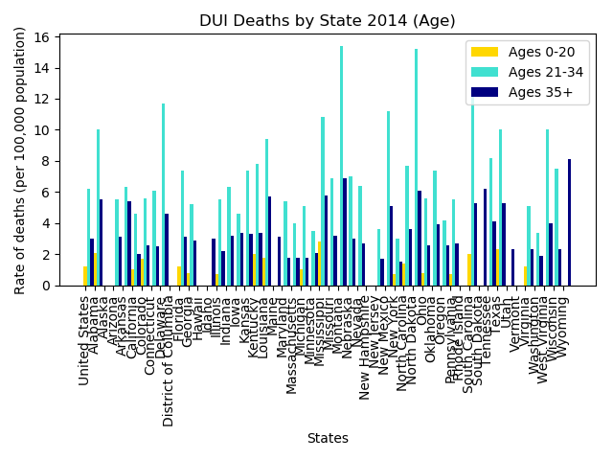
DUI Deaths by State (2014)
Ages 21-34 had the highest rates
Highest in Montana
Lowest in New Hampshire
Ages 0-20 had the lowest rates
Highest in Mississippi
Lowest in Illinois
Ages 35+
Highest in Wyoming
Lowest in New Hampshire

Slide 16
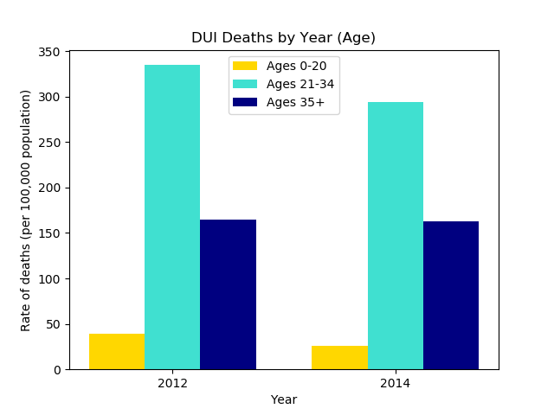
DUI Deaths by Year
14% reduction of deaths
For Ages 21-34
Generation most impacted by TNCs
53% reduction of deaths
For Ages 0-20
Small reduction of deaths
For Ages 35+

Slide 17
Discussion
Men have higher rates of DUI deaths than women
However little correlation between Female DUI deaths and TNCs
Ages 21-34 had the highest rates as well as the highest correlation
Overall, correlation between DUI deaths and TNCs
Introduction of Uber/Lyft in 2012 caused a slight reduction in deaths

Slide 18
Post Mortem
Unable to find APIs with the data we needed
Difficulty finding the best way to separate the data for analysis
Issues having our graphs represent our data the way we wanted
Beneficial to analyze later years as popularity of TNCs increased

Slide 19
References
https://en.wikipedia.org/wiki/Uber
https://www.uber.com/blog/los-angeles/uber-la-officially-launched/
https://s3.amazonaws.com/uber-static/comms/PDF/Uber_Driver-Partners_Hall_Kreuger_2015.pdf
https://www.forbes.com/sites/briansolomon/2017/01/05/lyft-rides-tripled-last-year-but-remains-far-behind-uber/#7c1a1789199e
https://en.wikipedia.org/wiki/Transportation_network_company
https://en.wikipedia.org/wiki/DUI_laws_in_California
https://www.nhtsa.gov/risky-driving/drunk-driving#age-5056
https://mrcheckpoint.com/can-i-get-a-dui-removed-from-my-record-in-california/
https://www.edhat.com/news/dui-suspected-in-rollover-accident
https://catalog.data.gov/dataset/impaired-driving-death-rate-by-age-and-gender-2012-all-states-587fd

